Slide 1


Slide 2

Short for Programming Logic, Prolog is a high-level programming language based on formal logic. ...Prolog is sometimes called a declarative language or a rule-based language because its programs consist of a list of facts and rules.

Slide 3

Programming languages are of two kinds:
  Procedural (BASIC, For Tran, C++, Pascal, Java);
  Declarative (LISP, Prolog, ML).
In procedural programming, we tell the computer how to solve a problem.
In declarative programming, we tell the computer what problem we want solved.
(However, in Prolog, we are often forced to give clues as to the solution method).

Slide 4
In procedural languages, the procedure and control structure are defied by the programmer. The program manipulates data according to the defined procedure
With prolog, user defines a goal and computer must find both the procedure and the solution.
Prolog is Ideal for a problem that is unstructured in nature and the procedure to solve is unknown. What is known about the problem is stored as data.

Slide 5

Procedural languages | Object Oriented Languages
Basic, COBOL, Pascal, C | Prolog, LISP
use previously defined procedure to solve problem | use heuristics to solve problem
most efficient at numerical processing | most efficient at formal reasoning
systems created and maintained by programmers | systems created and maintained by knowledge engineers
use structured programming | interactive and cyclic development

Slide 6

Good at
  Grammars and Language processing,
  Knowledge representation and reasoning,
  Unification,
  Pattern matching,
  Planning and Search.
    i.e. Prolog is good at Symbolic AI.
Poor at:
  Repetitive number crunching,
  Representing complex data structures,
  Input/Output (interfaces).

Slide 7
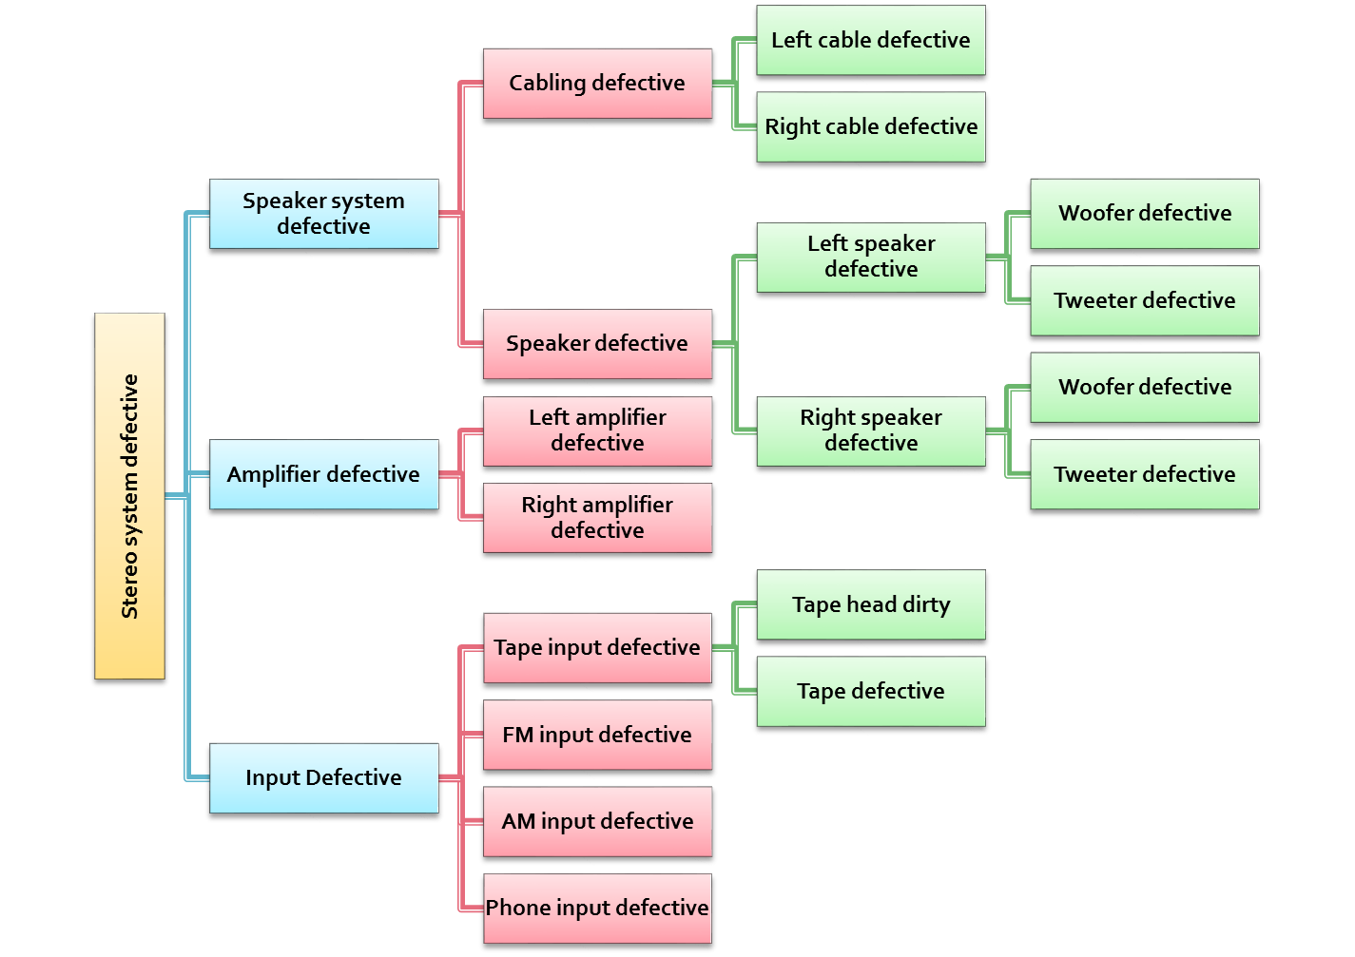

Slide 8

Expert systems:
  Expert systems are programs that uses inference techniques that involves formal reasoning normally performed by human expert to solve problem in a specific area of knowledge
  Expert system Can advice, diagnose, analyze and categories using a previously defined KB. KB is a collection of rules and facts often written in prolog

Slide 9
Natural language processing
Robotics
  To “see” and manipulate object in their environment
  Development of a robotic control programs that can use input data from sensor to control manipulators.
Gaming and simulation:
  Prolog is ideal for games and simulations involving formal reasoning.
  ELIZA, N Queen problems , various strategy games

Slide 10

Can compile stand alone programs
Full complement of standard predicates for many functions such as string operations, random file access, cursor control, graphics, windowing and sound are available
Functional interface to other procedural language are available
Declared variables are used
An integrated editor is provided

Slide 11

Dose not supports virtual memory
Inefficient in numerical calculation

Slide 12
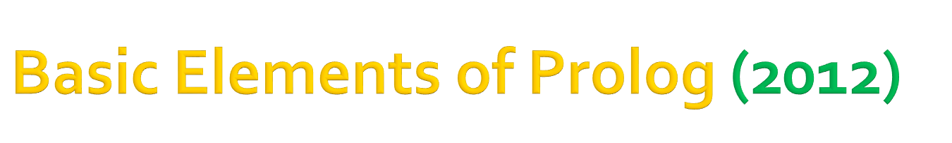
Our program is a database of facts(or Clause) and rules.
Some are always true (facts):
father( john, jim).
Some are dependent on others being true (rules):
parent( Person1, Person2 ) :-
father( Person1, Person2 ).
To run a program, we ask questions about the database.

Slide 13

Example Database:
John is the father of Jim.
Jane is the mother of Jim.
Jack is the father of John.
Person 1 is a parent of Person 2 if
Person 1 is the father of Person 2 or
Person 1 is the mother of Person 2.
Person 1 is a grandparent of Person 2 if
some Person 3 is a parent of Person 2 and
Person 1 is a parent of Person 3.
Example questions:
Who is Jim's father?
Is Jane the mother of Fred?
Is Jane the mother of Jim?
Does Jack have a grandchild?
Facts
Rules

Slide 14

Example Database:
John is the father of Jim.
Jane is the mother of Jim.
Jack is the father of John.
Person 1 is a parent of Person 2 if
Person 1 is the father of Person 2 or
Person 1 is the mother of Person 2.
Person 1 is a grandparent of Person 2 if
some Person 3 is a parent of Person 2 and
Person 1 is a parent of Person 3.
Example questions:
Who is Jim's father?
Is Jane the mother of Fred?
Is Jane the mother of Jim?
Does Jack have a grandchild?
Example Database:
father( john, jim ).
mother( jane, jim ).
father( jack, john ).
parent( Person1, Person2 ) :-
father( Person1, Person2 ).
parent( Person1, Person2 ) :-
mother( Person1, Person2 ).
grandparent( Person1, Person2 ) :-
parent( Person3, Person2 ),
parent( Person1, Person3 ).
Example questions:
goal: father( Who, jim ).
goal: mother( jane, fred ).
goal: mother( jane, jim ).
goal: grandparent( jack, _ ).

